Slide 1
Github: The beginning
Brock Kamrath

Slide 2

Introduction
Welcome to Version Control\Git\GitHub week!
In our lectures and exercises on version control with GitHub, we will largely utilize:
Happy Git and GitHub for the useR by Jennifer Bryan @ happygitwithr.com
Introduction to Github by Lise Montefiore for REEU P4 program
Git for Humans by Alice Bartlet

Slide 3
Today’s Schedule
Article Discussion Questions
Discussion of Terminal and Git
Important terms and concepts
Work through Chapter 12 of happygitwithr.com
Start Chapter 15: New Project, GitHub First of happygitwithr.com
There will be some time to work on this at the end of the lecture.

Slide 4
Discussion
You were asked to read
Sections 1-4 of Byran article (Excuse Me…)
Stewart Lowndes et al (Our path…)
What were your takeaways from the Bryan article?
What were your takeaways from the Stewart Lowndes article?

Slide 5
Discussion Questions
1. What the difference between Git and Github?

Slide 6
Discussion Questions
What the difference between Git and Github?
2. In the Our path… article, the authors discuss the implementation of version control/reproducibility (via Github and RStudio) in the global OHI assessment. How do you see version control/reproducability being implemented in your research?

Slide 7
Discussion Questions
What the difference between Git and Github?
In the Our path… article, the authors discuss the implementation of version control/reproducibility (via Github and RStudio) in the global OHI assessment. How do you see version control/reproducability being implemented in your research?
3. What do you think will be the largest obstacle to utilizing version control with GitHub?

Slide 8
Happy Git and GitHub for the useR
You all should have
Created your NCSU GitHub account
Upgraded RStudio to version 4.0
Installed and introduced yourself to Git (i.e completed Section 1: Installation)

Slide 9
Things to know
Git is program for version control of software
It was not built to be user friendly!
GitHub is the user friendly remote hosting site
The Git extension in RStudio allows for a user friendly GUI

Slide 10
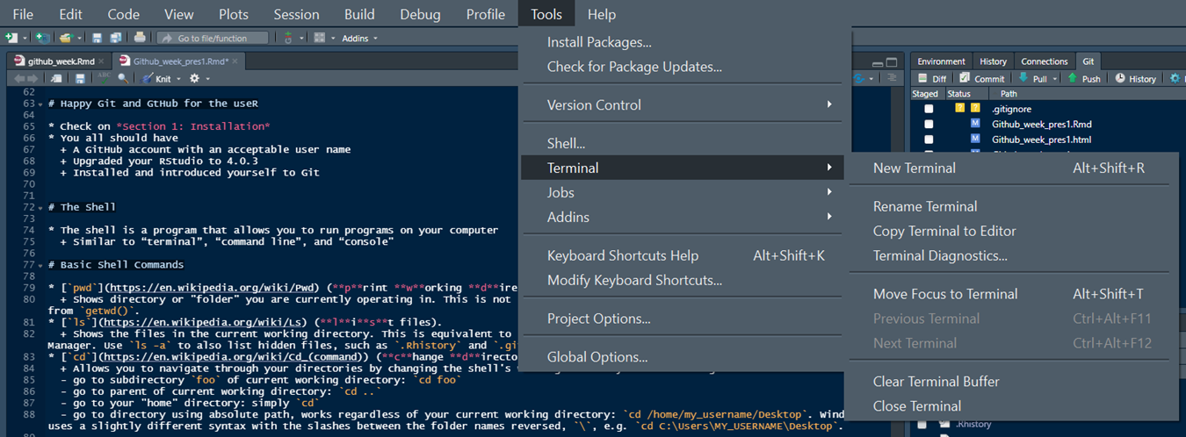
Interact with Git from the Terminal/Shell
The shell is a program that allows you to run programs on your computer
Similar to “terminal”, “command line”, and “console”
You can launch a shell from RStudio. This is often handy, because RStudio makes every effort to put you in a same working directory, i.e. in the current project.
Tools > Terminal launches a shell within RStudio, graphically and process-wise.
This is usually what you want.

Slide 11
Basic Shell Commands
pwd (print working directory).
Shows directory or “folder” you are currently operating in.
ls (list files).
Shows the files in the current working directory. This is equivalent to looking at the files in your Finder/Explorer/File Manager.
cd (change directory).
Allows you to navigate through your directories by changing the shell’s working directory. You can navigate like so:
go to subdirectory foo of current working directory: cd foo
go to parent of current working directory: cd ..
go to your “home” directory: simply cd
Use arrow-up and arrow-down to repeat previous commands. Or search for previous commands with CTRL + r.

Slide 12
Chapter 12: Connect RStudio to Git and GitHub
Objectives:
Make sure that you can all pull from and push to GitHub in RStudio on your local computer
Use RStudio to edit, commit, and push to your remote GitHub repo
Order of operation
Connect to GitHub
Make a repository (or repo) on GitHub
Clone the repo to your local computer via RStudio
Make a local change, commit, and push
Confirm local change propagated to the GitHub remote
Clean up

Slide 13
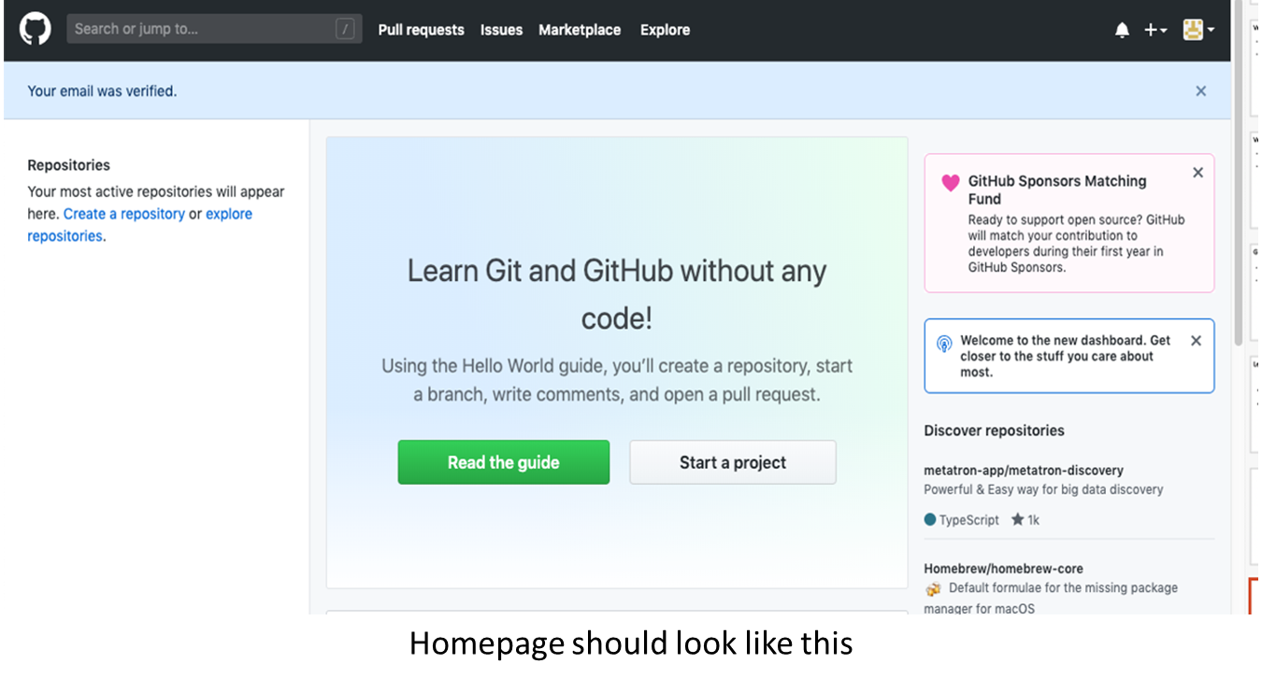
Connect to GitHub
Start by going to https://github.com and logging in

Slide 14
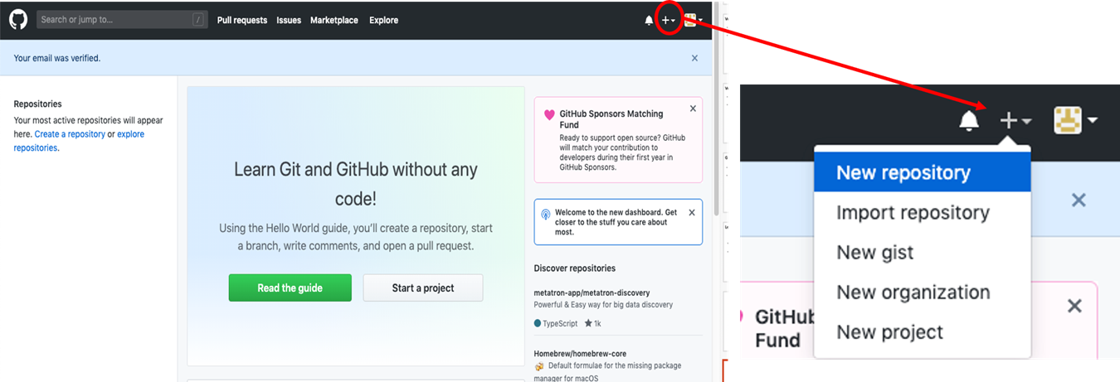
Make a repo on GitHub
Click the plus, then the “New repository” button.

Slide 15
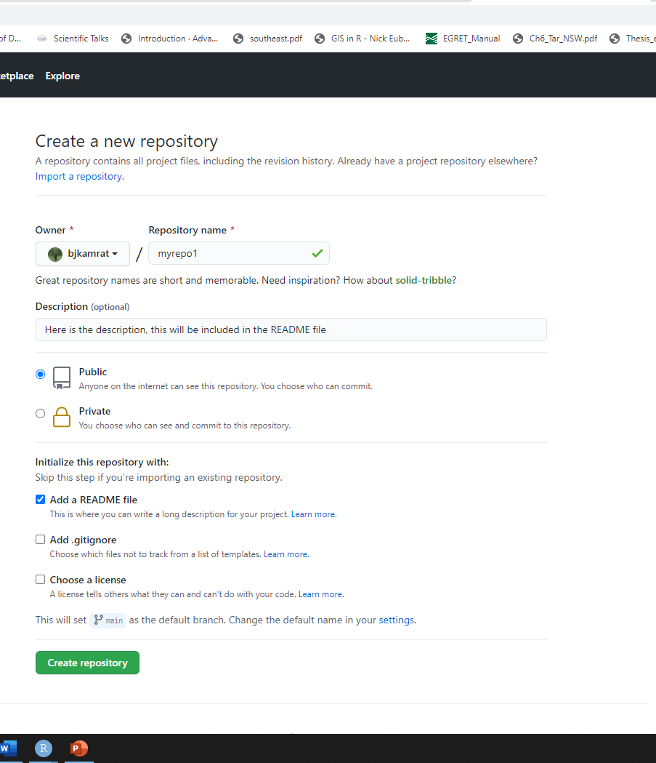
Make a repo on GitHub
How to fill this in
Repository name: myrepo (or whatever you wish, we’ll delete this soon anyway).
Description: “testing my setup” (or whatever, but some text is good for the README).
Public.
YES Initialize this repository with a README.
For everything else, just accept the default.
Click big green button “Create repository.”

Slide 16
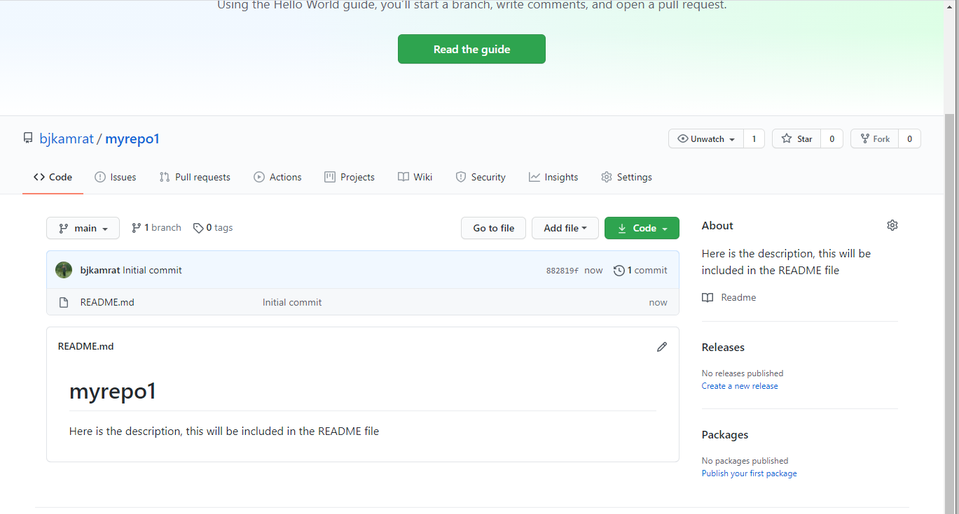
Make a repo on GitHub
You should see this

Slide 17
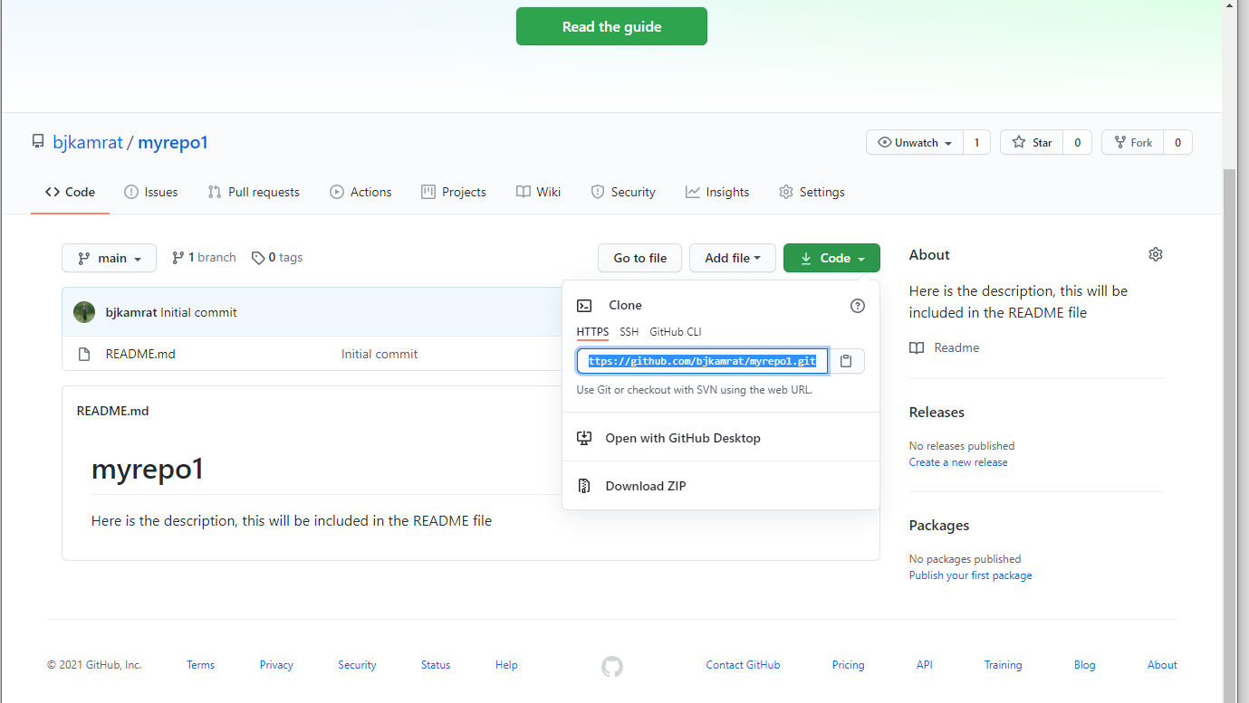
Clone the repo to your local computer
Copy the HTTPS clone URL to your clipboard via the green “Clone or Download” button.

Slide 18
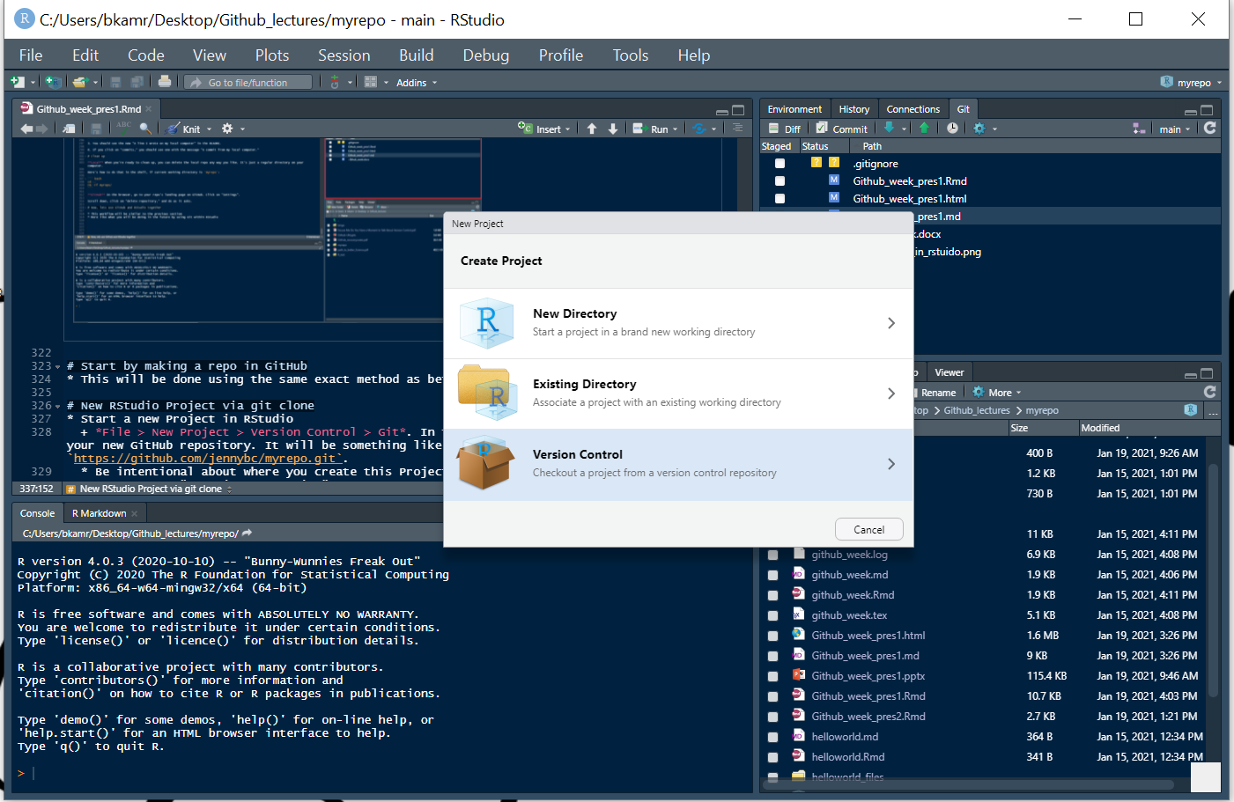
Clone the new GitHub repo to your local computer via RStudio
Start a new Project in RStudio
File > New Project > Version Control > Git.
In the “repository URL” paste the URL of your new GitHub repository.
https://github.com/bjkamrat/myrepo.git
Be intentional about where you create this Project.
Check "Open in new session
Click “Create Project” to create a new directory, which will be:
a directory or “folder” on your computer
a Git repository, linked to a remote GitHub repository
an RStudio Project

Slide 19
All of your R projects should have this set-up.
The new local RStudio Project should represent the new test remote repo created on GitHub

Slide 20
Make a local change, commit, and push
In your local RStudio Project modify the README.md file
Add the line “This is a line from RStudio”
Save your change

Slide 21
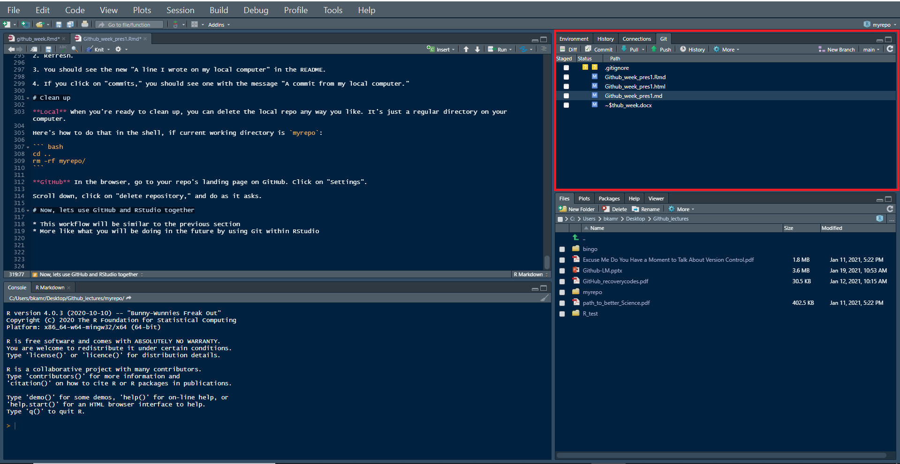
Now, commit these changes to your local repo. How?
In RStudio:
Click the “Git” tab in upper right pane.

Slide 22
Now, commit these changes to your local repo. How?
Click the white “Staged” box for README.md.
Click “Commit”.
“Comment” on your “commit”!
“Commit message”, such as “Commit from RStudio”.
Click “Commit”.

Slide 23
Pull then Push your local changes online to GitHub
First, Pull into RStudio the most updated verison of the GitHub Repo
You should see some message…
Already up to date.
Click the green “Push” button to send your local changes to GitHub. If you are challenged for username and password, provide them
You should see some message..
[master dc671f0] blah 3 files changed, 22 insertions(+) create mode 100644 .gitignore create mode 100644 myrepo.Rproj

Slide 24
Workflow
Do work somewhere.
Commit it.
Push it or pull it* depending on where you did it, but get local and remote “synced up”.
Repeat.
* Note that in general (and especially in future when collaborating with other developers) you will usually need to pull changes from the remote (GitHub) before pushing the local changes you have made. For this reason, it’s a good idea to try and get into the habit of pulling before you attempt to push.

Slide 25
Confirm local change propgated to GitHub
Go back to the browser. I assume we’re still viewing your new GitHub repo.
Refresh.
You should see the new “This is a line from RStudio” in the README.
If you click on “commits,” you should see one with the message “Commit from Rstudio”

Slide 26
Clean up
Local Computer:
When you’re ready to clean up, you can delete the local repo any way you like. It’s just a regular directory on your computer.
GitHub Remote:
In the browser, go to your repo’s landing page on GitHub. Click on “Settings”. * Scroll down, click on “delete repository,” and do as it asks.

Slide 27


Slide 28
Lets discuss some of the Git methodology/terminology
Git allows you to take snapshots of all the files in a folder
This folder is your repository or repo
When you commit, you take a snapshot, which you then push to Github with a comment
Think of taking a picture (commit) then posting (pushing) the picture to Instagram
You wouldn’t post a picture to Instagram without a comment

Slide 29
Git methodology/terminology
When you commit a file or files, additional information is saved along with the changes to the file
Who
When
What was changed
A comment on the change

Slide 30
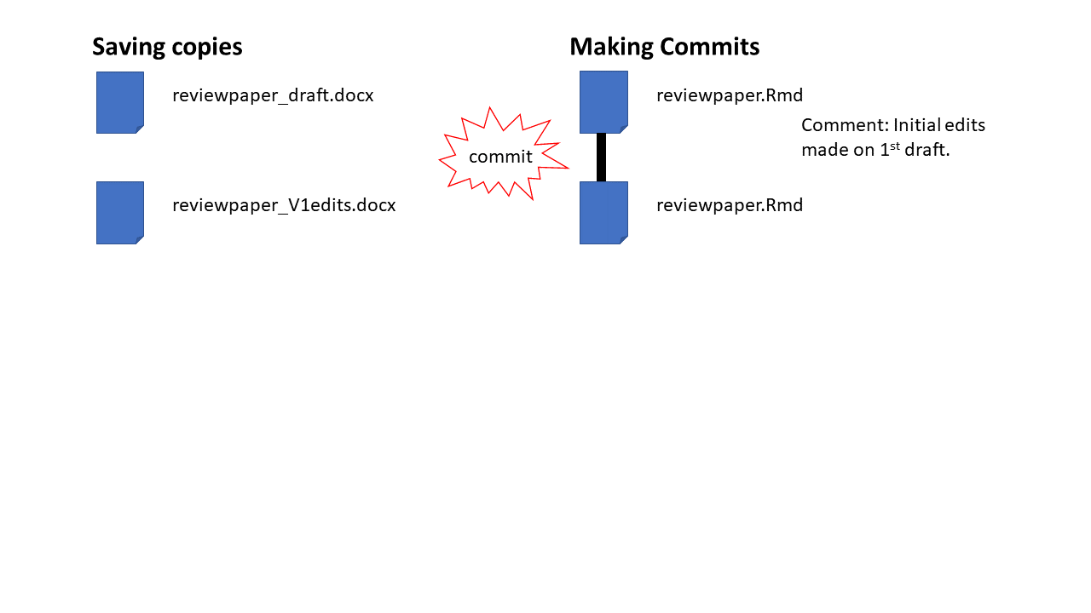
Git methodology/terminology
These snapshots act as version control

Slide 31
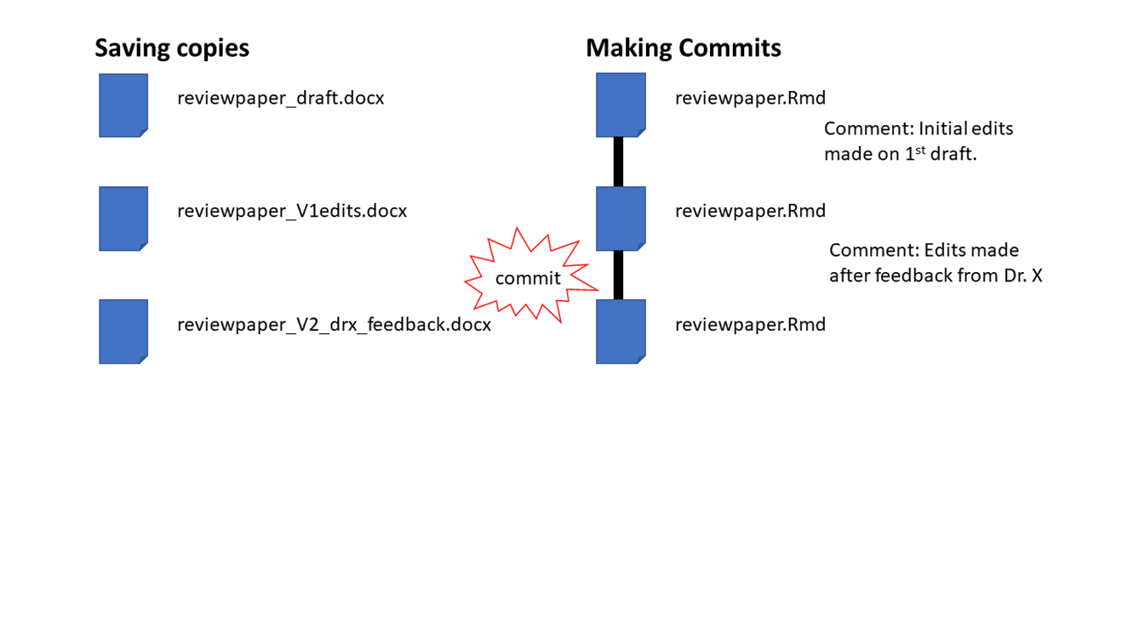
Git methodology/terminology
These snapshots act as version control

Slide 32
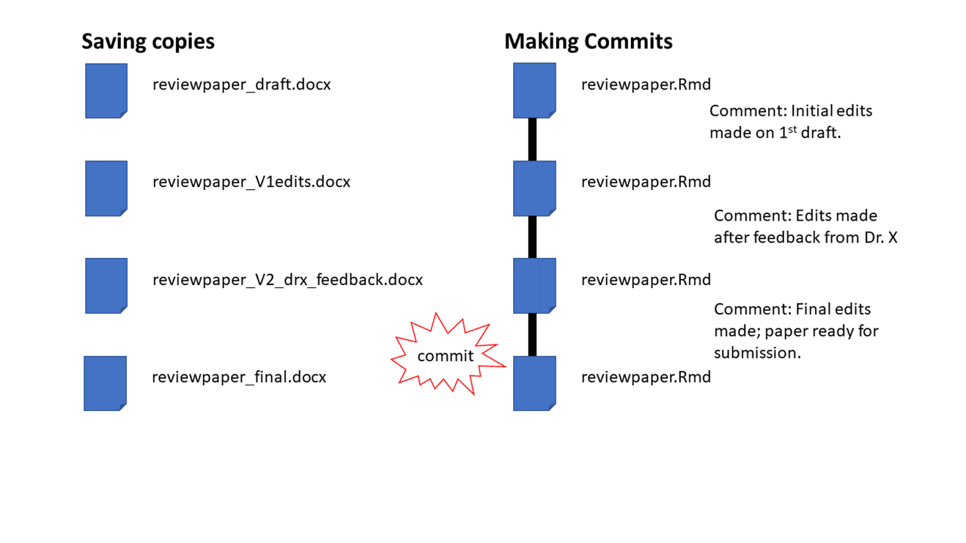
Git methodology/terminology
These snapshots act as version control

Slide 33
Git methodology/terminology
Git, or in our case GitHub, stores the history of your project
This lets you time travel to different versions of your project
You can check out these older versions of the project

Slide 34
Git methodology/terminology
What if you want to experiment with making some changes to files in your project?
you can do this by creating a branch
A branch is a moveable label attached to a commit

Slide 35
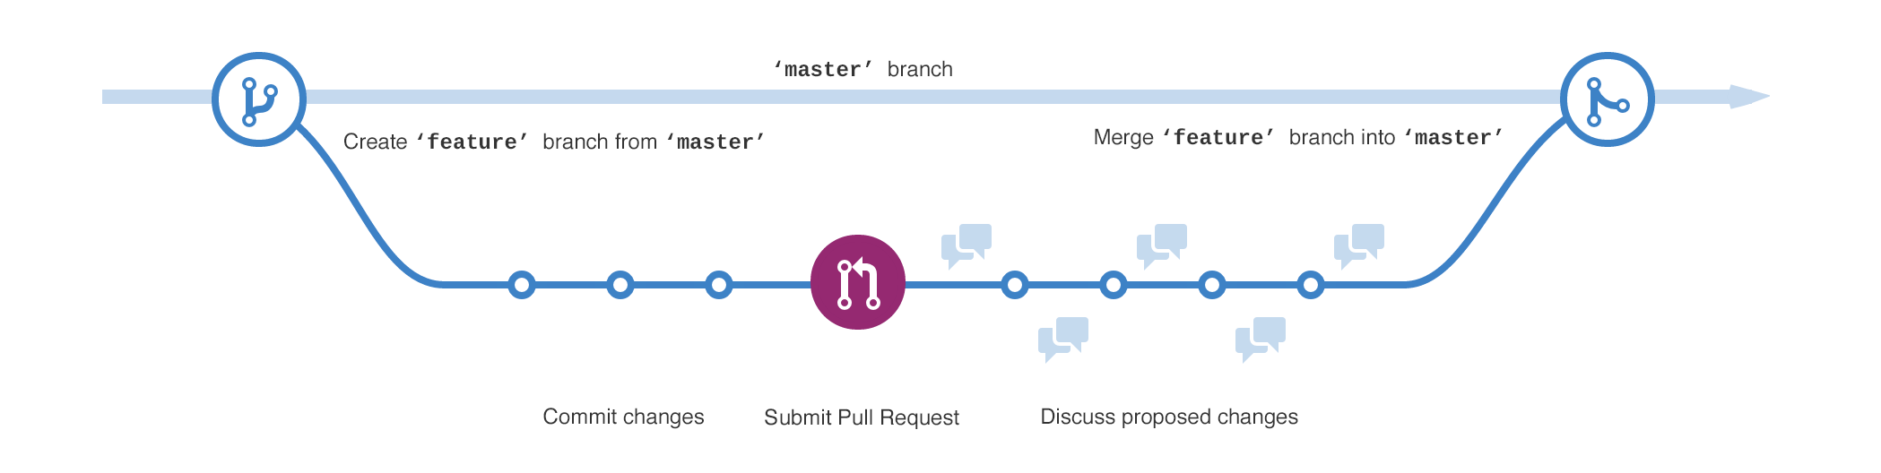
Git methodology/terminology
The default branch name in GitHub is master
To experiment with making some changes created a new branch
If you are happy with the changes you can merge them back into the master
In collaborative projects
Most changes should be done in a new branch
The master branch is often the version of the code that is published on a site

Slide 36
Git methodology/terminology
As you know, it is always good to back up your work
Typically, not on your local computer
This outside storage location is called a remote
GitHub is one very popular remote

Slide 37
Git methodology/terminology
To get work from a remote for the first time you must clone it to your local computer
We just did this!!
If you make a change at the local level,
You can commit the change
Then push it back to the remote
For someone else to have the most updated repo, they now need to pull your changes to their local computer

Slide 38
Summary
repo - your project folder
commit - snapshot of repo
checkout - time travel to specific commit
branch - a moveable label that point to a commit
merge - combining two branches
remote - a computer/server with the repository on it
clone - the first time you get the repo from the remote
push - send commits (with comments) to a remote
pull - get updated repo from a remote
Haven’t yet discussed
fork or pull request or upstream

Slide 39


Slide 40
Now, lets use GitHub and RStudio together (Chapter 15)
This workflow will be similar to the previous section
More like what you will be doing in the future by using Git within RStudio

Slide 41
Start by making a repo in GitHub
This will be done using the same exact method as before
Remember:
Repository name: myrepo (or whatever you wish, we’ll delete this soon anyway).
Description: “testing my setup” (or whatever, but some text is good for the README).
Public.
YES Initialize this repository with a README.
For everything else, just accept the default.
Click big green button “Create repository.”

Slide 42
From Here
With the rest of the class period, I would like you to work on CH 15 and go through CH 16 and 17.
For Thursday (2/4/21), you need to
Complete Chapter 15
Finish reading Byran article (Excuse Me…)

